Slide 1
Introduction to Cybersecurity
Chapter 1
Dr. Mohammed Tawfik

Slide 2
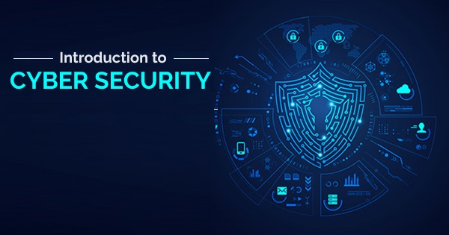
Chapter 1:
Introduction to Cyber Security
Dr. Mohammed Tawfik

Slide 3
Intro to Cybersecurity unit , assessment and marking:
30marks for the following:
Attendance and Classwork
Participations
Assignments and Quiz
Presentations and projects
30 marks , Midterm exam
40marks , Final exam

Slide 4
Intro to Cybersecurity main chapters for this Semester:
Introduction to Cybersecurity
Cybersecurity Concepts
Physical and Computer Security
Malware
Cyber Crime, Kali Linux, Digital Forensics, Firewall , and Webs
Ethical Hacking, Penetration Testing

Slide 5
Outline
Definition of Security and InfoSec
Definition of Cybersecurity
History of Cybersecurity
Cybersecurity Objectives (CIA)
Security Implementation
Data Ownership
The Systems Development Life Cycle

Slide 6
What is the definition of Cybersecurity ?
Give us your opinion

Slide 7
What Is Information?
knowledge that you get about someone or something : facts or details about a subject.
The value of information comes from the characteristics it possesses.
* Availability *Accuracy * Authenticity
* Confidentiality * Integrity *Utility *Possession

Slide 8
What Is Security?
Security is protection from adversaries, or resilience against, potential harm (or other unwanted coercive change) caused by others, by restraining the actions of others to unwanted action.
A successful organization should have multiple layers of security in place:
Physical security
Personal security
Operations security
Communications security
Network security

Slide 9
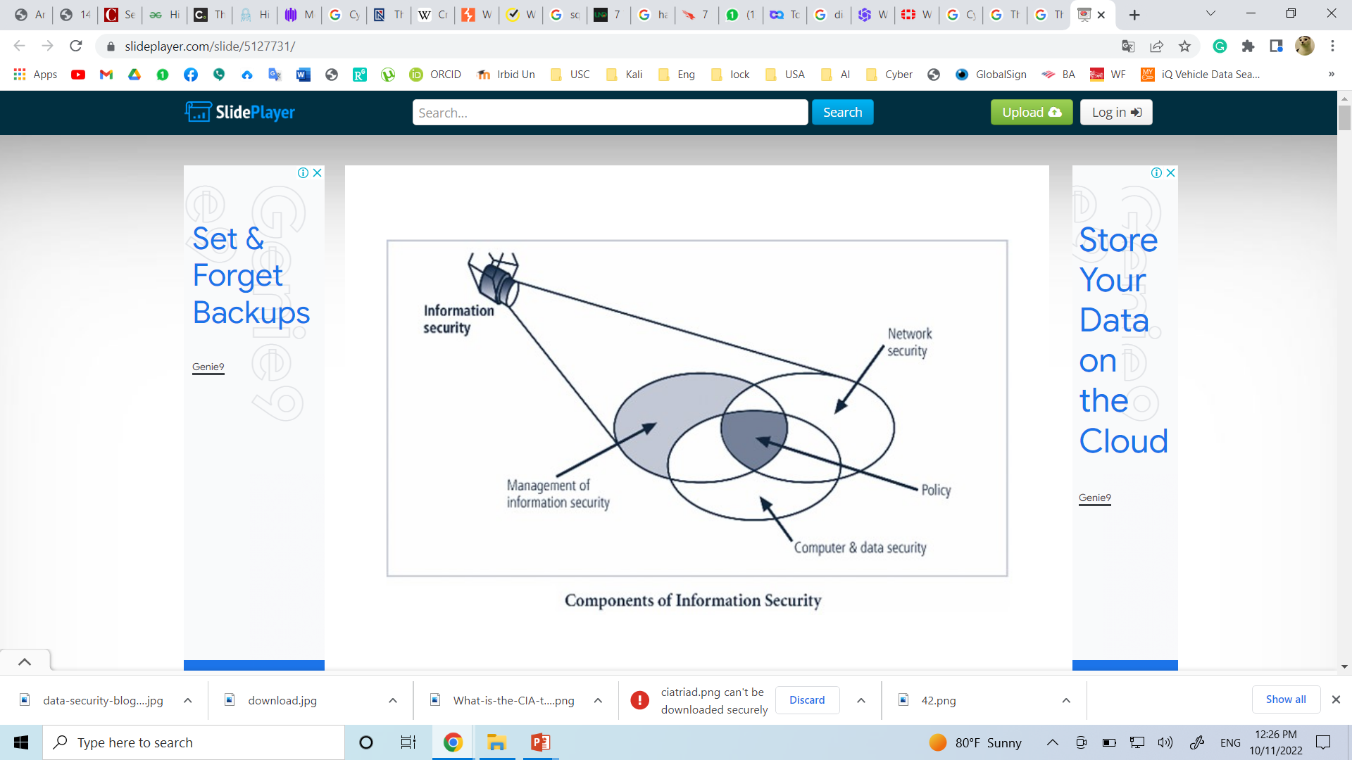
What is Information Security (InfoSec)?
•
Information security: The protection of information and its critical elements, including systems and hardware that use, store, and transmit that information
•
Necessary tools: policy, awareness, training, education, technology
•

Slide 10
What Is the Cyber?
Cyber: is a prefix that denotes a relationship with information technology (IT). Anything relating to, or involving computing, or computer networks such as the internet, falls under the cyber category.
Cyberspace: Cyberspace is the environment where data storage and communications using computer networks occur.
Cyber Attack: A cyber attack is a standoff attack to disrupt, disable, destroy, or control a computing environment or to access controlled information.
Cybercrime: Cybercrime is any crime which is carried out using information technology or which targets information technology.

Slide 11
What is Cybersecurity?
•
The term Cybersecurity is used to refer to the security offered through on-line services to protect your online information.
Cyber security is the application of technologies, processes, and controls to protect systems, networks, programs, devices and data from cyber attacks. It aims to reduce the risk of cyber attacks and protect against the unauthorized exploitation of systems, networks, and technologies.
•
Cybersecurity includes all aspects of security; Physical, Technical, Environmental, Regulations and Compliance including Third Parties involved in delivering an objective.
•

Slide 12
Why Cybersecurity Is Important ?
Our world today is ruled by technology and we can’t do without it at all. From booking our flight tickets, to catching up with an old friend, technology plays an important role in it.
However, the same technology may expose you when it’s vulnerable and could lead to loss of essential data.
Cyber security, alongside physical commercial security has thus, slowly and steadily, become one of the most important topics in the business industry to be talked about.
With an increasing amount of people getting connected to Internet, the security threats that cause massive harm are increasing also.

Slide 13
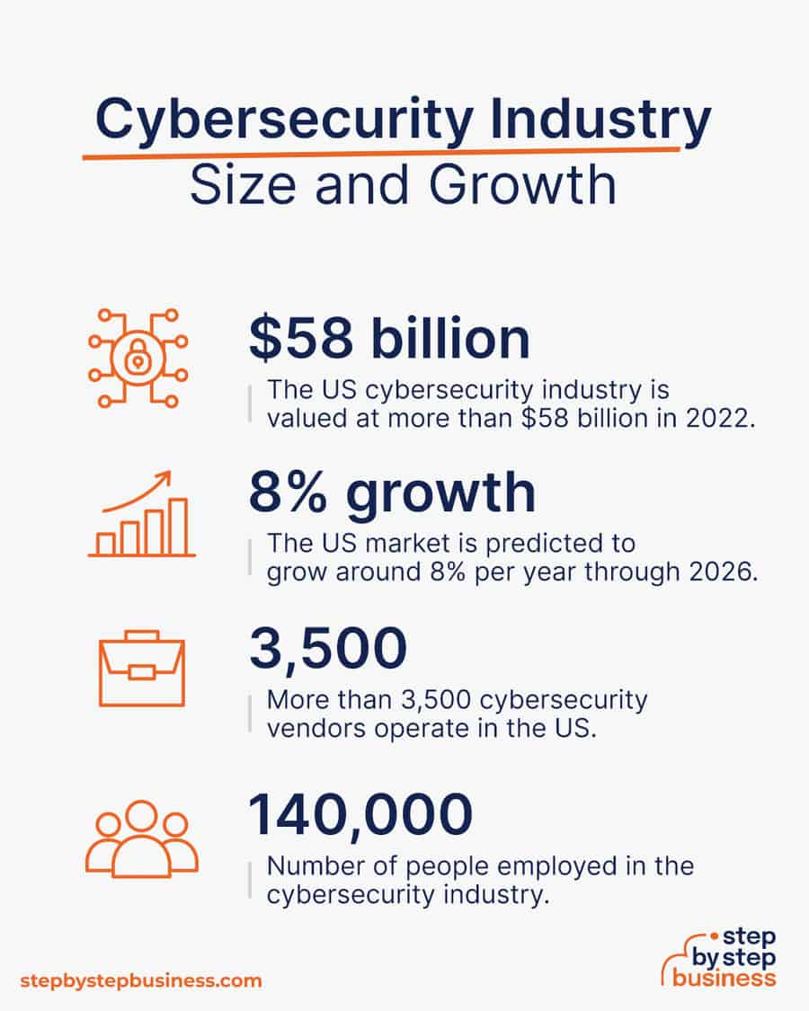
Why Cybersecurity is Important?
Cyber security is necessary since it helps in securing data from threats such as data theft or misuse, also safeguards your system from viruses.
Cyber security becomes important as Business are being carried now on Network of Networks. Computer networks have always been the target of criminals, and it is likely that the danger of cyber security breaches will only increase in the future as these networks expand, but there are sensible precautions that organizations can take to minimize losses from those who seek to do harm.

Slide 14
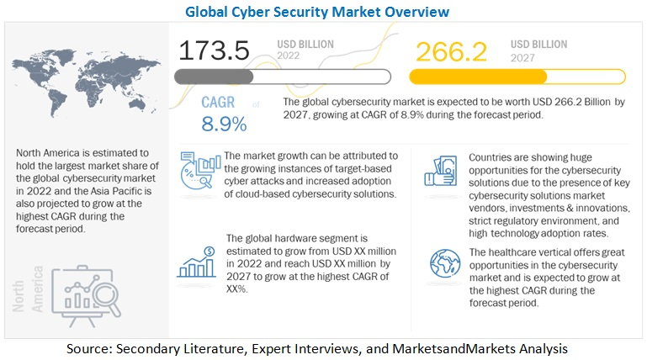

Slide 15
The History Of Information Security
Computer security began immediately after the first mainframes were developed.
Groups developing code-breaking computations during World War II created the first modern computers
Physical controls were needed to limit access to authorized personnel to sensitive military locations
Only rudimentary controls were available to defend against physical theft, espionage, and sabotage

Slide 16
The 1960s
Department of Defense’s Advanced Research Project Agency (ARPA) began examining the feasibility of a redundant networked communications.
Larry Roberts developed the project from its inception.
Objectives: develop networking and resource sharing

Slide 17
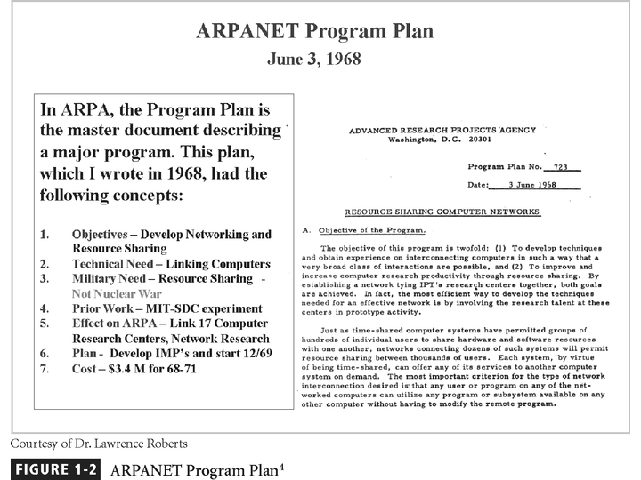
Figure 1-2 - ARPANET
Notes:
.

Slide 18
The 1970s and 80s
ARPANET grew in popularity as did its potential for misuse
Fundamental problems with ARPANET security were identified
No safety procedures for dial-up connections to the ARPANET
User identification and authorization to the system were non-existent
In the late 1970s the microprocessor expanded computing capabilities and security threats

Slide 19
The Start of the Study of Computer Security
Information Security began with Rand Report R-609
The scope of computer security grew from physical security to include:
Safety of the data
Limiting unauthorized access to that data
Involvement of personnel from multiple levels of the organization

Slide 20
The 1990s
Networks of computers became more common, so too did the need to interconnect the networks.
Resulted in the Internet, the first manifestation of a global network of networks.
In early Internet deployments, security was treated as a low priority.

Slide 21
The Present
The Internet has brought millions of computer networks into communication with each other – many of them unsecured.
Ability to secure each now influenced by the security on every computer to which it is connected.

Slide 22
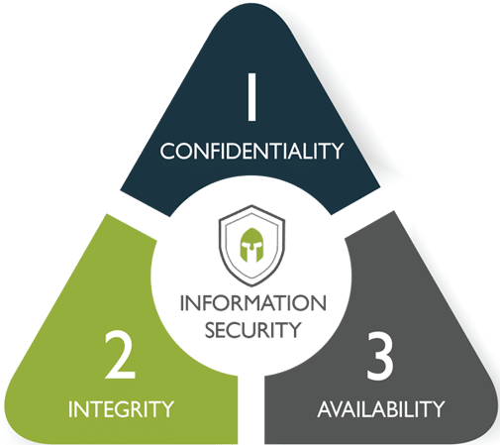
Cyber Security Objectives (CIA)
The three letters in "CIA triad" stand for Confidentiality, Integrity, and Availability. The CIA triad is a common model that forms the basis for the development of security systems. They are used for finding vulnerabilities and methods for creating solutions.
The confidentiality, integrity, and availability of information is crucial to the operation of a business, and the CIA triad segments these three ideas into separate focal points. This differentiation is helpful because it helps guide security teams as they pinpoint the different ways in which they can address each concern.

Slide 23
Confidentiality
♦Confidentiality refers to protecting information from being accessed by unauthorized parties. In other words, only the people who are authorized to do so can gain access to sensitive data.
♦ A failure to maintain confidentiality means that someone who shouldn't have access has managed to get it, through intentional behavior or by accident. Such a failure of confidentiality, commonly known as a breach.

Slide 24


Integrity
♦Integrity refers to ensuring the authenticity of information—that information is not altered, and that the source of the information is genuine (original and true).
♦ The property of safeguarding the accuracy and completeness of assets

Slide 25
Integrity
♦ Imagine that you have a website and you sell products on that site. Now imagine that an attacker can shop on your web site and maliciously alter the prices of your products, so that they can buy anything for whatever price they choose. That would be a failure of integrity, because your information—in this case, the price of a product—has been altered and you didn't authorize this alteration.

Slide 26

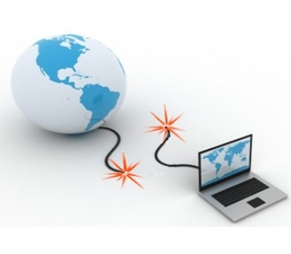
Availability
♦ Availability means that information is accessible by authorized users.
♦Information and other critical assets are accessible to customers and the business when needed.
♦Note, information is unavailable not only when it is lost or destroyed, but also when access to the information is denied or delayed.

Slide 27
Security Implementation: 1) Bottom-up Approach
Security from a grass-roots effort - systems administrators attempt to improve the security of their systems.
Key advantage - technical expertise of the individual administrators.
Seldom works, as it lacks a number of critical features:
participant support
organizational staying power

Slide 28
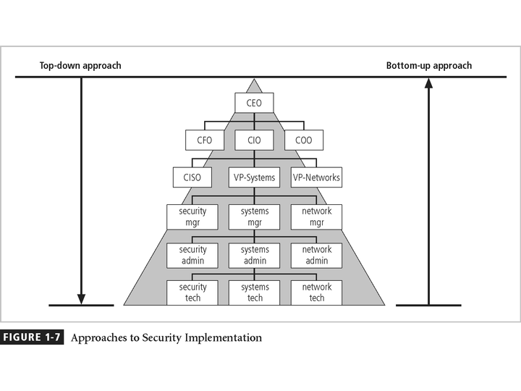
Figure 1-7 – Approaches to Security Implementation

Slide 29
2) Top-down Approach
Initiated by upper management:
issue policy, procedures, and processes
dictate the goals and expected outcomes of the project
determine who is accountable for each of the required actions
This approach has strong upper management support, a dedicated champion, dedicated funding, clear planning, and the chance to influence organizational culture
May also involve a formal development strategy referred to as a systems development life cycle
Most successful top-down approach

Slide 30
Data Ownership
Why is ownership of data important?
Data ownership formalizes the role of data owners and establishes accountability, assigning responsibility for managing data from creation to consumption. It puts rules and processes in place to ensure that the right people define usage directives, set quality standards, and consistently resolve data issues.
Data Owner - responsible for the security and use of a particular set of information
Data Custodian - responsible for the storage, maintenance, and protection of the information.
Data Users - the end systems users who work with the information to perform their daily jobs supporting the mission of the organization.

Slide 31
Components of an Information System
Information System (IS) is entire set of software, hardware, data, people, procedures, and networks necessary to use information as a resource in the organization.
Components Of An Information System To fully understand the importance of information security, it is necessary to briefly review the elements of an information system.
An Information System (IS) is much more than computer hardware; it is the entire set of software, hardware, data, people, and procedures necessary to use information as a resource in the organization.

Slide 32
The Systems Development Life Cycle
Information security must be managed in a manner similar to any other major system implemented in the organization.
Using a methodology
ensures a rigorous process
avoids missing steps
The goal is creating a comprehensive security posture/program

Slide 33
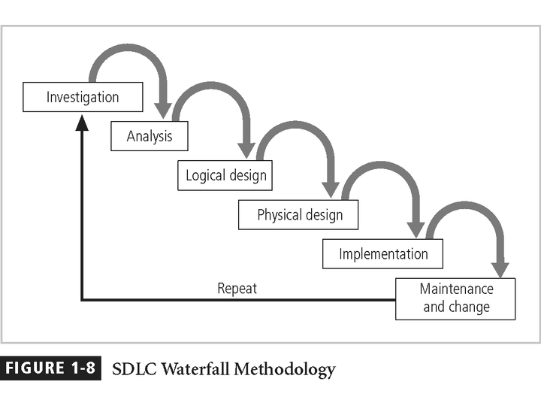
Figure 1-8 – SDLC Waterfall Methodology

Slide 34
SDLC and the SecSDLC
The SecSDLC may be
event-driven - started in response to some occurrences or
plan-driven - as a result of a carefully developed implementation strategy
At the end of each phase comes a structured review

Slide 35
1) Investigation
What is the problem the system is being developed to solve?
The objectives, constraints, and scope of the project are specified
A preliminary cost/benefit analysis is developed
A feasibility analysis is performed to assesses the economic, technical, and behavioral feasibilities of the process

Slide 36
2) Analysis
Consists primarily of
assessments of the organization
the status of current systems
capability to support the proposed systems
Analysts begin to determine
what the new system is expected to do
how the new system will interact with existing systems
Ends with the documentation of the findings and a feasibility analysis update

Slide 37
3) Logical Design
Based on business need, applications are selected capable of providing needed services
Based on applications needed, data support and structures capable of providing the needed inputs are identified
Finally, based on all of the above, select specific ways to implement the physical solution are chosen
At the end, another feasibility analysis is performed

Slide 38
4) Physical Design
Specific technologies are selected to support the alternatives identified and evaluated in the logical design.
Selected components are evaluated based on a make-or-buy decision.
Entire solution is presented to the end-user representatives for approval.

Slide 39
5) Implementation
Components are ordered, received, assembled, and tested
Users are trained and documentation created
Users are then presented with the system for a performance review and acceptance test

Slide 40
6) Maintenance and Change
Tasks necessary to support and modify the system for the remainder of its useful life.
The life cycle continues until the process begins again from the investigation phase.
When the current system can no longer support the mission of the organization, a new project is implemented.

Slide 41
Security Systems Development Life Cycle (SecSDLC)
The same phases used in the traditional SDLC adapted to support the specialized implementation of a security project
Basic process is identification of threats and controls to counter them
The SecSDLC is a coherent program rather than a series of random, seemingly unconnected actions

Slide 42
1) Investigation
Identifies process, outcomes and goals of the project, and constraints
Begins with a statement of program security policy
Teams are organized, problems analyzed, and scope defined, including objectives, and constraints not covered in the program policy
An organizational feasibility analysis is performed

Slide 43
2) Analysis
Analysis of existing security policies or programs, along with documented current threats and associated controls.
Includes an analysis of relevant legal issues that could impact the design of the security solution.
The risk management task (identifying, assessing, and evaluating the levels of risk) also begins.

Slide 44
3) Logical & Physical Design
Creates blueprints for security
Critical planning and feasibility analyses to determine whether or not the project should continue
In physical design, security technology is evaluated, alternatives generated, and final design selected
At end of phase, feasibility study determines readiness so all parties involved have a chance to approve the project

Slide 45
4) Implementation
The security solutions are acquired (made or bought), tested, and implemented, and tested again.
Personnel issues are evaluated and specific training and education programs conducted.
Finally, the entire tested package is presented to upper management for final approval.

Slide 46
5) Maintenance and Change
The maintenance and change phase is perhaps most important, given the high level of ingenuity in today’s threats.
The reparation and restoration of information is a constant duel with an often unseen adversary.
As new threats emerge and old threats evolve, the information security profile of an organization requires constant adaptation.

Slide 47

Information Security: Is it an Art or a Science?
With the level of complexity in today’s information systems, the implementation of information security has often been described as a combination of art and science.

Slide 48
Thanks you

